Slide 1

Florence Hosting Overview Airbnb Market Analysis
Muna Radhi

Slide 2
Florence Airbnb Listing
Core Challenge
Market is complex and highly competitive
Difficult to identify Host’s success-driven factors
Objectives
Host distribution by neighbourhood
Guest room & location preferences
Pricing patterns
Top hosts’ key traits (response speed, pricing, flexibility).

Slide 3
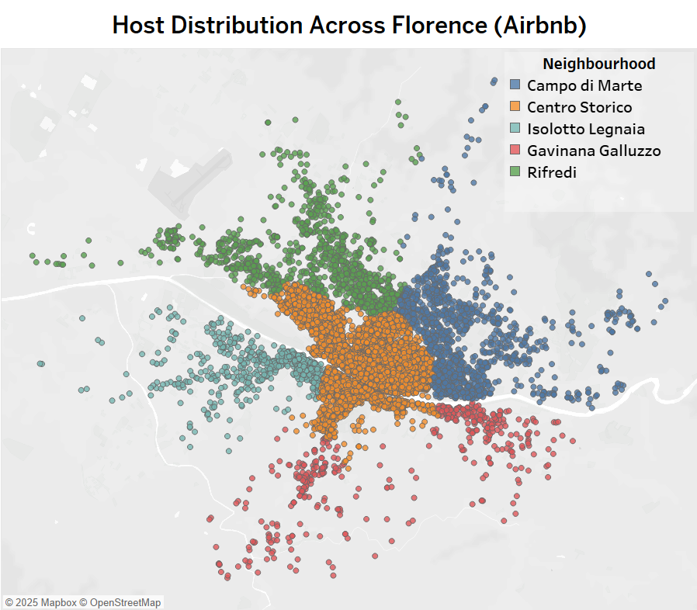
Florence Airbnb Overview: Host Locations and Categories
13044
Total Number of Listing
Percentage of Listings by Neighbourhood and Room Type

Slide 4
Guest preferences – No Reviews as a Demand indicator
Top Neighborhoods
Centro Storico & Isolotto Legnaia
Top Properties
Shared Room & Entire home/apt

Slide 5
Guests Preferences – No Reviews as a Demand indicator
Short-term rentals receive more reviews on average than long-term rentals
Rental types
as per Florence regulations
(BNBCalc, 2025)
Short Term
30 days or less
Long Term
More than 30 days

Slide 6
Guest Willingness to Pay - Pricing Patterns
Most Expensive: Centro Storico Most Affordable: Rifredi
Most Expensive: Hotel Room Most Affordable: Shared Room

Slide 7
Insights from Top Performers - communication
Host Ranking according to number of review last 12 months ( Top 10% , Middle , Bottom 10%)
95% of Top Hosts are responding within one hour
Top Hosts have slightly higher rate in term of Communication

Slide 8
Insights from Top Performers – Price & Value
Top Hosts are charging lowest Prices per night
Top & middle Hosts have better rating in term of value

Slide 9
Insights from Top Performers – Stay & Flexibility
Top Hosts demonstrate greater flexibility in minimum nights, catering to both short-term and long-term

Slide 10
Key Insights for Investors
Location
Centro Storico (central, high demand).
Isolotto Legnaia (affordable growth potential).
Property Type
Shared rooms (scarce, cheap, but highly demanded).
Host Strategy:
Fast communication & quick response.
Competitive, value-driven pricing.
Flexible minimum night stay.

Slide 11
References
BNBCalc. Florence Short-Term Rental Regulation: A Guide. Retrieved from https://www.bnbcalc.com/blog/short-term-rental-regulation/Florence-Italy-Guide

